Slide 1

What is a PID controller
A feedback loop control system
  It looks at what happened in the past to help adjust its output in the future
You give it a target, and the current position. It tries to get the error to zero between the target and your position
Proportional – error * fixed amount (Kp)
Integral – sum of error * Ki
Derivative – Try to slowdown as the rate of change increases to prevent overshoot * Kd

Slide 2
What is a PID controller
Target = set point
  Where the controller is trying to get to
Error = current reading – set point
  The difference between the desired location and the current location
Output = the amount we want to affect the control variable to try and reduce the error

Slide 3
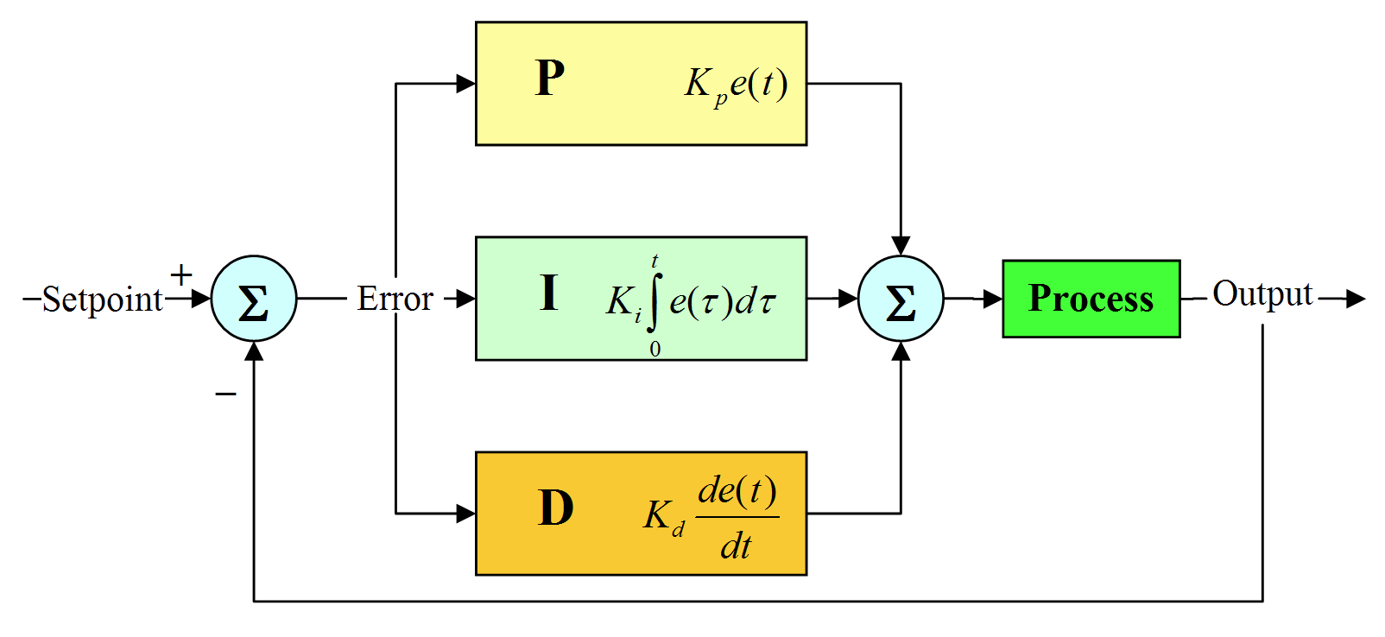
What is a PID controller

Slide 4
Our Problem
We want the robot to drive forward in a certain direction
We need to turn and then move
Robot
Desired
Location

Slide 5
First we turn
We have an error in our current angle
“Forward” will always be relatively 0 degrees regardless of what direction that is as the direction we want to move is at 0 error
If we make “forward” 90 degrees then we are trying to create an error of 90 in our system – which is weird
i.e. the front of the robot is forward, not compass North
Error = 40
Robot
0

Slide 6
Open loop controller
An open loop controller has no looping of output to input (open)
If we move 10 degrees per second and need to move 40 degrees then we need full power for 4 seconds: 10 * 4 = 40
Input
Process
Output
Need +40 degrees
Full power for 4 seconds
x/10

Slide 7
Open loop turn result
What happened?
I guess we moved 15 degrees per second, so we have an error of -20 (i.e. we need to turn -20 degrees)
We could fix this by initially moving for 2.6 seconds from our original position: 2.6 * 15 = 40
Robot
0
Error = -20

Slide 8
Open loop turn result 2
We still have an error of 27. WTF?
The output signal to movement mapping isn't 1:1
The robot turns 5-15 degrees per second
  exaggerated, but real systems are like this
i.e. if we apply a power of 12V to the motor we move somewhere between 5-15 degrees
Error = 27
Robot
0

Slide 9
Closed loop controller
Feedback the error we are seeing in the system and keep changing our output to match
Rather than “move for 4 seconds” tell it to move for 0.1 seconds and then check again
Input
Process
Output
Feedback

Slide 10
Proportional Controller
Error term * Kp
i.e. angle error * Kp (0.5)
  40 * 0.5 = 20 power to motor
  32 * 0.5 = 16 power to motor
  28 * 0.5 = 14 power to motor
  24 * 0.5 = 12 power to motor
  Etc... until we get to 0
We're getting their... slowly...

Slide 11
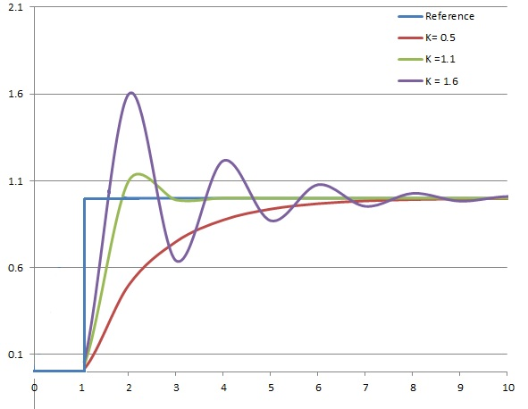
Proportional Controller

Slide 12
Being close enough
0.005 degrees * 0.5 = 0.0025 power
0.004 degrees * 0.5 = 0.002 power
0.004 degrees * 0.5 = 0.002 power
0.004 degrees * 0.5 = 0.002 power
… 0.002 power isn't enough to move robot ...
We instead say “if you're within +/- 0.1 degrees then exit controller” (return 0 power)

Slide 13
Proportional Controller
Error term * Kp
i.e. angle error * Kp (0.5)
  40 * 0.5 = 20 power to motor
  32 * 0.5 = 16 power to motor
  28 * 0.5 = 14 power to motor
  24 * 0.5 = 12 power to motor
  Etc... until we get to 0
We're getting their... slowly...
We're far away,
but slowing down

Slide 14
Integral Control
Integrate the error and add more output
P controller
PI controller
Integral will decrease
due to overshoot
Integral speed up due to Kp error
+ some additional output power
due to there being an integral
Overshoot: Kp power output is 0,
but the Ki integral is still
adding power

Slide 15
Integral Control
Add the output from the Kp and the Ki terms together to get the total
Process
Kp * error
Ki * integral
Input
Output
Feedback

Slide 16
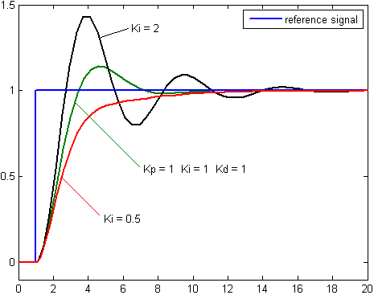
Integral Control

Slide 17
Offset error – P only
Some of Rob's donut get stuck in the left wheel so the robot keeps moving 0.5 degrees to the left
P controller: we are currently 0.5 degrees off course
  Error 0.5 * Kp (2) = 1 power, which moves 0.5 degrees right
  0.5 degrees right (from P controller) + -0.5 to the left due to donut = 0 degrees movement
  So we are still pointing 0.5 degrees off course

Slide 18
Offset error – P and I (PI controller)
PI controller: we are currently 0.5 degrees off course
  Error 0.5 * Kp (2) + intg(0) * Ki (1) = 1 power, which moves 0.5 degrees right
  0.5 right + -0.5 left = 0 degrees movement
  Error 0.5 * Kp (2) + intg(0.5) * Ki (1) = 1.5 power, which moves 0.75 degrees right
  0.75 right + -0.5 left = 0.25 degrees right (now @0.25)
  Error 0.25 * Kp (2) + intg(0.75) * Ki (1) = 1.25 power, which moves 0.625 degrees right
  0.625 right + -0.5 left = 0.125 (now @0.125)
The integral build up is forcing us to turn right despite the constant -0.5 left turn imbalance

Slide 19
So PI is always better than P?
No, not always
It can increase over shoot
It can increase set time (time to get to 0)
It can reduce stability (keeps messing with the output)
Windup can be an issue

Slide 20
I windup
T=0
P = +1
I = +0
T=500
P = +1
I = +100
T=100
P = +0.25
I = +150
We are basically at the
setpoint but I is HUGE!
I keeps getting bigger if we start far from the setpoint
We we reach the setpoint I will push us past it for a long time

Slide 21
Prevent I windup
There is lots of in-depth research into PID controllers
We can just keep it simple
Limit the size of I to prevent too much build up
  If (I > 50) then I = 50
Set I back to zero the first time we cross the Y axis
  If (cross Y axis && first_cross) I=0
  This will allow us to accelerate towards setpoint if we are far away, but stop once we are relatively close

Slide 22
Derivative Control
If in doubt, just use PI and skip the D
Predict the future and adjust the output according
The faster the rate of change of the error the more D will scale back the output
1
What D is saying:
1. Error's not changing much, I won't do much
2. We're changing a lot, we should slow down
3. We're not changing much again, I won't do anything
2
3
Error

Slide 23
Derivative Control

Slide 24
Weren't we going to drive forward?
Robot
Use the turn PID controller
Robot
Robot
Robot
Robot
Eangle=40
Edist=10
Eangle=10
Edist=10
Eangle=-5
Edist=10
Eangle=0
Edist=10

Slide 25
Drive forward
Robot
Robot
Robot
We forgot about Rob's donut in the wheel!

Slide 26
What to do?
We run our turn controller in 2 modes:
  Turn then exit
  Continuous course
We first use the controller to turn until we are pointing in the correct direction and exit so that we can start the drive forward command
As part of driving forward we start the turn PID controller again at 0 degrees with 0 error to stay on our current heading
We will stop the drive and turn controllers once we have traveled the correct distance

Slide 27
A PID controller is like a tire
You make a tire. It goes on a car and allows it to drive. So everything is good?
  What if it's a race car?
  What if it's an off road car?
  What if it's an 18 wheeler truck?
  What if it's a moon buggy?
One tire doesn't fit every car, one PID controller doesn't fit every problem
You need to customize, tweak, and tune

Slide 28
Potential Issues
Minimum movement unit
Momentum
  Turning
  Going forwards/backwards
Gravity
Long windup time
Offset errors
Steady state error
No controller present, that's just
how mechanical objects work
Robot
Robot

Slide 29
Potential Solutions
Exit once output is below a threshold
Pause the controller for a time to allow momentum to take its course
Consider known effects/offsets
  Gravity will never make us fall up
    It's easier for the motor to “push” downwards
Have a high gain and low gain controllers for large or small distances – big move tuned and little tweak tuned
Measure the variability/errors under best-case conditions so that you're not trying to achieve something impossible
  Can we move from 15.001 degrees to 15.002?

Slide 30
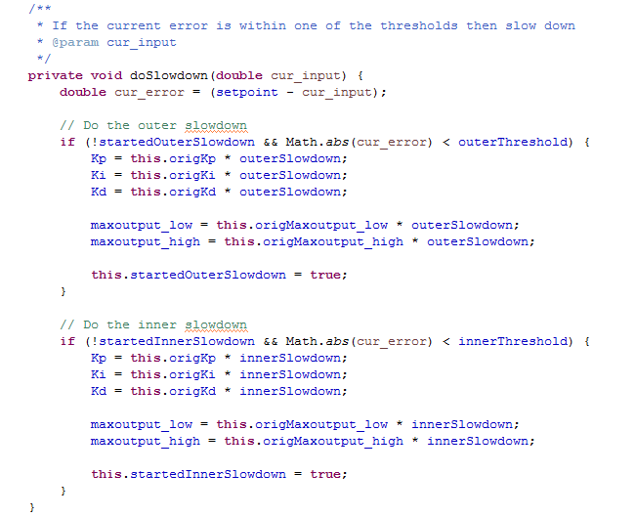
We did a gain slowdown

Slide 31
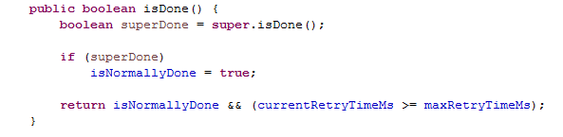
We did a momentum wait

Slide 32
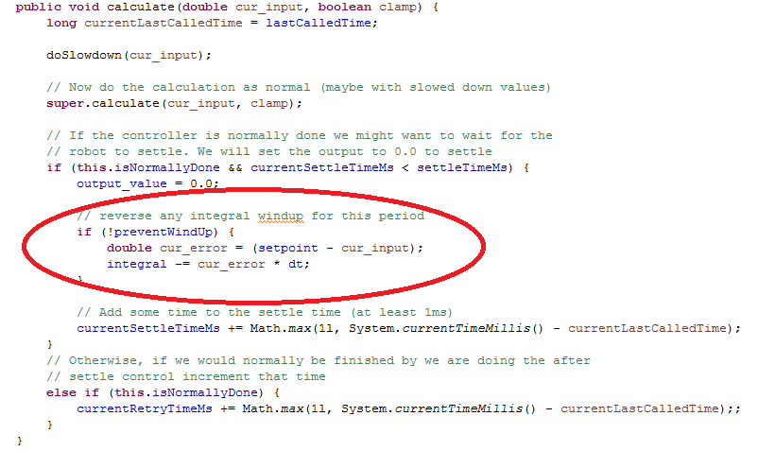
We tried to stop windup

Slide 33
What We Should Have Done
- hindsight is a wonderful thing
>30 - <-30 degrees
Saturated controller
i.e. Always Max power
+30 - -30 degrees
High-gain controller
i.e. fast
Robot
Straight
Super-low-gain
i.e. tweak level
+5 - -5 degrees
Low-gain controller
i.e. slow
Desired
Location

